Slide 1
Bioperl Modules
Ms. Sermarani Nadar Department of Bioinformatics

Slide 2
BioPerl
BioPerl is an active open source software project supported by the Open Bioinformatics Foundation.
BioPerl is a collection of Perl libraries for analyzing biological data.
Sequence Analysis, Phylogenetic Analysis, Protein Structure Analysis, etc.
It is NOT a separate programming language.
Installation:
http://strawberryperl.com/ - STRAWBERRY PERL
https://medstrand.wordpress.com/installing-bioperl-on-windows/ - STEPS FOR BIOPERL INSTALLATION

Slide 3
Bioperl Modules
Perl Modules
Perls script
input
Perl Interpreter
output
Bioperl and Perl

Slide 4
Why Bioperl for Bio-informatics?
Perl is good at file manipulation and text processing, which make up a large part of the routine tasks in bio-informatics.
Perl language, documentation and many Perl packages are freely available.
Perl is easy to get started in, to write small and medium-sized programs.

Slide 5
Disadvantage of Bioperl(Future Aspects)
Except sequence handling, all other modules are not complete.
The portability is not very good, not all modules will work with on all platforms.

Slide 6
Bio::Seq Module

Slide 7
Bio::Seq
It is central Module
Using Bio::Seq module we can create Bio::Seq object
Bio::Seq

Slide 8
Bio::Seq - A sequence and a collection of sequence features
(an aggregate) with its own annotation.
$seq_obj = Bio::Seq->new(-seq => "aaaatgggggggggggccccgtt",
-display_id => "#12345",
-desc => "example 1",
-alphabet => "dna" );
Args : -seq => sequence string
-display_id => display id of the sequence
-desc => alias for description
-alphabet => skip alphabet guess and set it to dna, rna or protein

Slide 9
Title : seq
Usage : $string = $seqobj->seq();
Function: Get or set the sequence as a string of letters. An error is thrown if the sequence contains invalid characters
Returns : A scalar
Args : - Optional new sequence value (a string) to set
- Optional alphabet (it is guessed by default)

Slide 10
Title : subseq
Usage : $substring = $seqobj->subseq(10,40);
$substring = $seqobj->subseq(10,40);
Function: Return the subseq from start to end, where the first sequence
character has coordinate 1 number is inclusive, ie 1-2 are the
first two characters of the sequence.
Returns : a string
Args : integer for start position
integer for end position

Slide 11
Title : length
Usage : $len = $seqobj->length();
Function: Get the stored length of the sequence in number of symbols (bases or amino acids).
Returns : integer representing the length of the sequence.
Title : display_id or display_name
Usage : $id_string = $seqobj->display_id();
Function: Get or set the display id, the common name of the sequence object.
Returns : A string for the display ID
Args : Optional string for the display ID to set

Slide 12
Title : alphabet
Usage : if( $seqobj->alphabet eq 'dna' ) { # Do something }
Function: Get/set the alphabet of sequence, one of
'dna', 'rna' or 'protein'. This is case sensitive.
Returns : a string either 'dna','rna','protein'. NB - the object must
make a call of the type - if there is no alphabet specified it
has to guess.
Args : optional string to set : 'dna' | 'rna' | 'protein'
Title : desc or description
Usage : $seqobj->desc($newval);
Function: Get/set description of the sequence.
Returns : value of desc (a string)
Args : newvalue (a string or undef, optional)

Slide 13
Creating a sequence and an Object
Example 1:
use Bio::Seq;
$seq_obj = Bio::Seq->new(-seq => "aaaatgggggggggggccccgtt",
-display_id => "#12345",
-desc => "example 1",
-alphabet => "dna" );
print $seq_obj->seq();

Slide 14
Bio::SeqIO Module

Slide 15
Bio::SeqIO
Handler for SeqIO Formats
Used for biological file handles
Read or Write sequences
Supported formats include fasta, genbank, embl, swiss (SwissProt), Entrez Gene and tracefile formats such as abi (ABI) objects

Slide 16
Sequence Input/Output
The Bio::SeqIO system was designed to make getting and storing sequences to and from the myriad of formats as easy as possible.

Slide 17
Bio::Perl has a number of other easy-to-use functions, including
get_sequence - gets a sequence from standard, internet accessible
databases
read_sequence - reads a sequence from a file
read_all_sequences - reads all sequences from a file
new_sequence - makes a bioperl sequence just from a string
write_sequence - writes a single or an array of sequence to a file
translate - provides a translation of a sequence
translate_as_string - provides a translation of a sequence, returning back just the sequence as a string
blast_sequence - BLASTs a sequence against standard databases at
NCBI
write_blast - writes a blast report out to a file
write_seq - writes a sequence into a file
revcom – reverse compliments

Slide 18
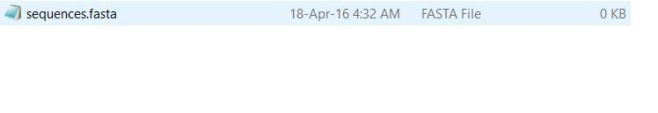
Writing a sequence to a file
Example 2:
use Bio::SeqIO;
$seqio_obj = Bio::SeqIO->new(-file => ">sequence.fasta', -format
=> 'fasta' );

Slide 19
Note that > in the -file argument. This character indicates that we’re going to write to the file named sequence.fasta, the same character we’d use if we were using Perl’s open() function to write to a file. The -format argument, fasta, tells the object that it should create the file in fasta format.

Slide 20
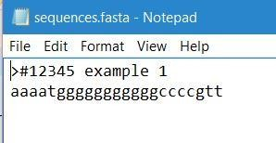
Writing a sequence to a file
Example 3:
use Bio::Seq; use Bio::SeqIO;
$seq_obj = Bio::Seq->new(-seq => "aaaatgggggggggggccccgtt",
-display_id => "#12345",
-desc => "example 1",
-alphabet => "dna" );
$seqio_obj = Bio::SeqIO->new(-file => '>C:\\Users\\LINO\\Desktop\\sequence.fasta', - format => 'fasta' );
$seqio_obj->write_seq($seq_obj);

Slide 21
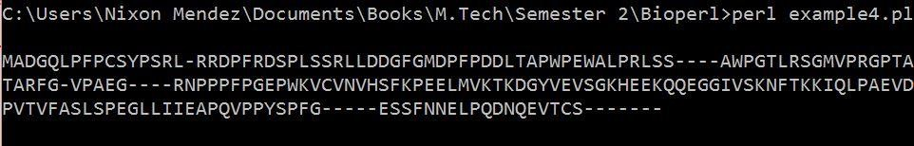
Retrieving a sequence from a file
Example 4:
use Bio::SeqIO;
$seqio_obj = Bio::SeqIO->new(-file => " C:\\Users\\LINO\\Desktop\\abc\\ seq.fasta", -format
=> "fasta" );
$seq_obj = $seqio_obj->next_seq; print $seq_obj->seq,"\n";

Slide 22
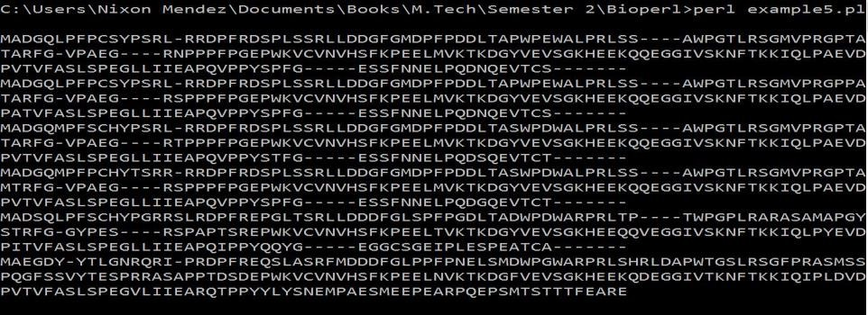
Retrieving multiple sequence from a file
Example 5:
use Bio::SeqIO;
$seqio_obj = Bio::SeqIO->new(-file => " C:\\Users\\LINO\\Desktop\\abc\\sequence.fasta", -format
=> "fasta" );
while ($seq_obj = $seqio_obj->next_seq)
{
print $seq_obj->seq,"\n";}
}

Slide 23
Format the sequences
SeqIO object can read a stream of sequences in one format: Fasta, EMBL, GenBank, Swissprot, PIR, GCG, SCF, phd/phred, Ace, or raw (plain sequence), then write to another file in another format
Ex:
use Bio::SeqIO;
$in = Bio::SeqIO->new('-file' => "C:\\Users\\LINO\\Desktop\\abc\\sequence.fasta",
'-format' => 'Fasta');
$out = Bio::SeqIO->new('-file' => ">C:\\Users\\LINO\\Desktop\\abc\\seq123.embl",'-format' => 'EMBL');
while ( my $seq = $in->next_seq() )
{$out->write_seq($seq); }

Slide 24
Manipulating sequence data
$seqobj->trunc(5,10) # truncation from 5 to 10 as new object
$seqobj->revcom # reverse complements sequence
$seqobj->translate # translation of the sequence

Slide 25
revcom() and translate() Example
use Bio::Seq;
use Bio::SeqIO;
$seqio_obj = Bio::SeqIO->new(-file => "C:\\Users\\LINO\\Desktop\\abc\\seq.fasta", -format=> "fasta" );
$seq_obj = $seqio_obj->next_seq;
print $seq_obj->seq,"\n";
$trans = $seq_obj->translate;
print "\n",$trans->seq;
$trans = $seq_obj->revcom;
print "\n",$trans->seq;

Slide 26
trunc() Example
use Bio::Seq;
use Bio::SeqIO;
$seqio_obj = Bio::SeqIO->new(-file => "C:\\Users\\LINO\\Desktop\\abc\\seq.fasta", -format=> "fasta" );
$seq_obj = $seqio_obj->next_seq;
print $seq_obj->seq,"\n";
$trans = $seq_obj->trunc(10,14);
print "\n",$trans->seq;

Slide 27
AlignIO
You may already be familiar with the Bio.SeqIO module which deals with files containing one or more sequences. The purpose of the SeqIO module is to provide a simple uniform interface to assorted sequence file formats.
Similarly, Bio.AlignIO deals with files containing one or more sequence alignments represented as Alignment objects.

Slide 28
It allows the user to:
convert between alignment formats
extracting specific regions of the alignment
generating consensus sequences.
Example:
use Bio::AlignIO;
my $io = Bio::AlignIO->new(
-file => "receptors.aln",
-format => "clustalw" );

Slide 29
Bio::AlignIO->new()
1. -file
A file path to be opened for reading or writing. The usual Perl conventions apply:
'file' # open file for reading
'>file' # open file for writing
'>>file' # open file for appending
'+<file' # open file read/write
2. -format
Specify the format of the file.

Slide 30
SimpleAlign module
Description:
It handles alignments of sequences

Slide 31
Method:
new
Usage : my $aln = new Bio::SimpleAlign();
Function : Creates a new simple align object
Returns : Bio::SimpleAlign
Args : -source => string representing the source program where this alignment came from
each_seq
Usage : foreach $seq ( $align->each_seq() )
Function : Gets an array of Seq objects from the alignment
Returns : an array
length()
Usage : $len = $ali->length()
Function : Returns the maximum length of the alignment.

Slide 32
percentage_identity
Usage : $id = $align->percentage_identity
Function: The function calculates the average percentage identity. Percent identity refers to a quantitative measurement of the similarity between two sequences (DNA, amino acid or otherwise).
Returns : The average percentage identity
no_sequences
Usage : $depth = $ali->no_sequences
Function : number of sequence in the sequence alignment
Returns : integer

Slide 33
Functions
$in->next_aln();
$out->write_aln($aln);
$mini_aln = $aln->slice(20,22);
$new_aln = $aln->remove_columns([20,22]);

Slide 34
Write a bioperl to read align sequence and perform methods and functions:
use Bio::AlignIO;
$out = Bio::AlignIO->new(-file => "C:\\Users\\LINO\\Desktop\\abc\\out.aln.pfam" ,
-format => 'pfam');
$aln = $out->next_aln();
print $aln->length,"\n";
print $aln->no_sequences,"\n";
print $aln->percentage_identity,"\n";
$mini_aln = $aln->slice(20,22);
$new_aln = $aln->remove_columns([20,22]);

Slide 35
Read fasta file and write as Alignment file i.e .fasta to .pfam file
use Bio::AlignIO;
$in = Bio::AlignIO->new(-file => "C:\\Users\\LINO\\Desktop\\abc\\seq.fasta",
-format => 'fasta');
$out = Bio::AlignIO->new(-file => ">C:\\Users\\LINO\\Desktop\\abc\\out1.aln.pfam" ,
-format => 'pfam');
while ( my $aln = $in->next_aln() ) {
$out->write_aln($aln);
}

Slide 36
THANK YOU

